Slide 1

University management system

Slide 2


Introduction
We aim to develop an efficient University Management Tracker. using Java technologies. This tool addresses the need for Easy Solution which covers all aspects of Universities, Colleges or Schools. University Tracker covers Streamlining administrative tasks, academic processes, and student services, UMS offers efficient management of departments and workflows.

Slide 3

Detailed overview
Key features include Login/Signup Options, Add/Delete/Search Student Ids, Staff Details, tracking of management fees, updates regarding the university, Total Income tracking, and more. The system also allows customization, accommodating specific needs like student’s name, the percentage of marks scored by them, etc . This document outlines the project's requirements, aiding organizations in maintaining and managing their data effectively.

Slide 4

KEY FEATURES:
Provide insights into track database patterns.
Help users Monitoring and decision support system.
Ease and accuracy of reporting.
Inbuilt Utilites.

Slide 5

Software applications used:
Database connector:
MySQL & JDBC
Programing language: JAVA ( SWING AND AWT )
Operating system : Windows 7+
IDE : JAVA INTELLIJ IDEA

Slide 6

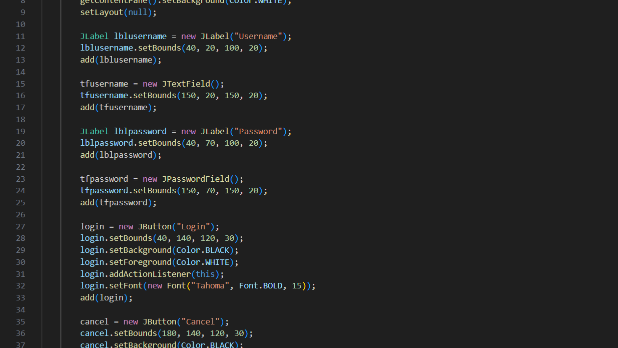
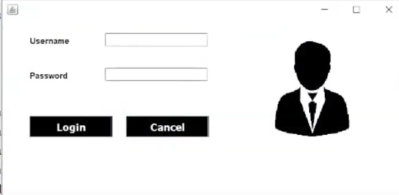
Snippets of code

Slide 7

Team members
VS SANTHOSH:
E23CSEU1150
Designing and developing the user interface using Java Swing or JavaFX.This includes creating forms for adding students, viewing student details, adding courses, managing faculty, etc.Responsibilities may also include implementing form validations and ensuring a user-friendly interface.Backend Development.
SOURABH PAL:
E23CSEU1156
Worked on the backend logic and database integration. This involves setting up a database schema for storing student details, courses, faculty information, etc. Implementing CRUD (Create, Read, Update, Delete) operations for managing data in the database. Handling database connections, executing SQL queries, and ensuring data integrity and security. Functionality Implementation.
BHANUTEJA PADAMATA
E23CSEU1144
Implementing the core functionalities of the system.This includes functionalities like adding new students, assigning courses to students, managing faculty, generating reports, etc. Implementing business logic for calculating grades, generating student IDs, handling course enrollment, etc. Testing the functionalities and ensuring they work as expected.

Slide 8


THANK YOU
😇

